Slide 1

Your Website Is Losing You Customers
Every day, potential customers visit your website. And most of them leave — no call, no booking, no sale. Not because they don't need what you offer. Because your website failed to convert them.

Slide 2

You're Paying to Send Visitors Nowhere
The Hard Truth
Paid Ads
Businesses spend thousands on ads, SEO, social media, and referrals to drive traffic — then send those hard-earned visitors to a website that does little more than sit there.
That's not a marketing problem. That's an expensive website problem.
Driving clicks that don't convert
SEO & Social
Organic traffic with nowhere to go
Referrals
Warm leads that slip through the cracks

Slide 3

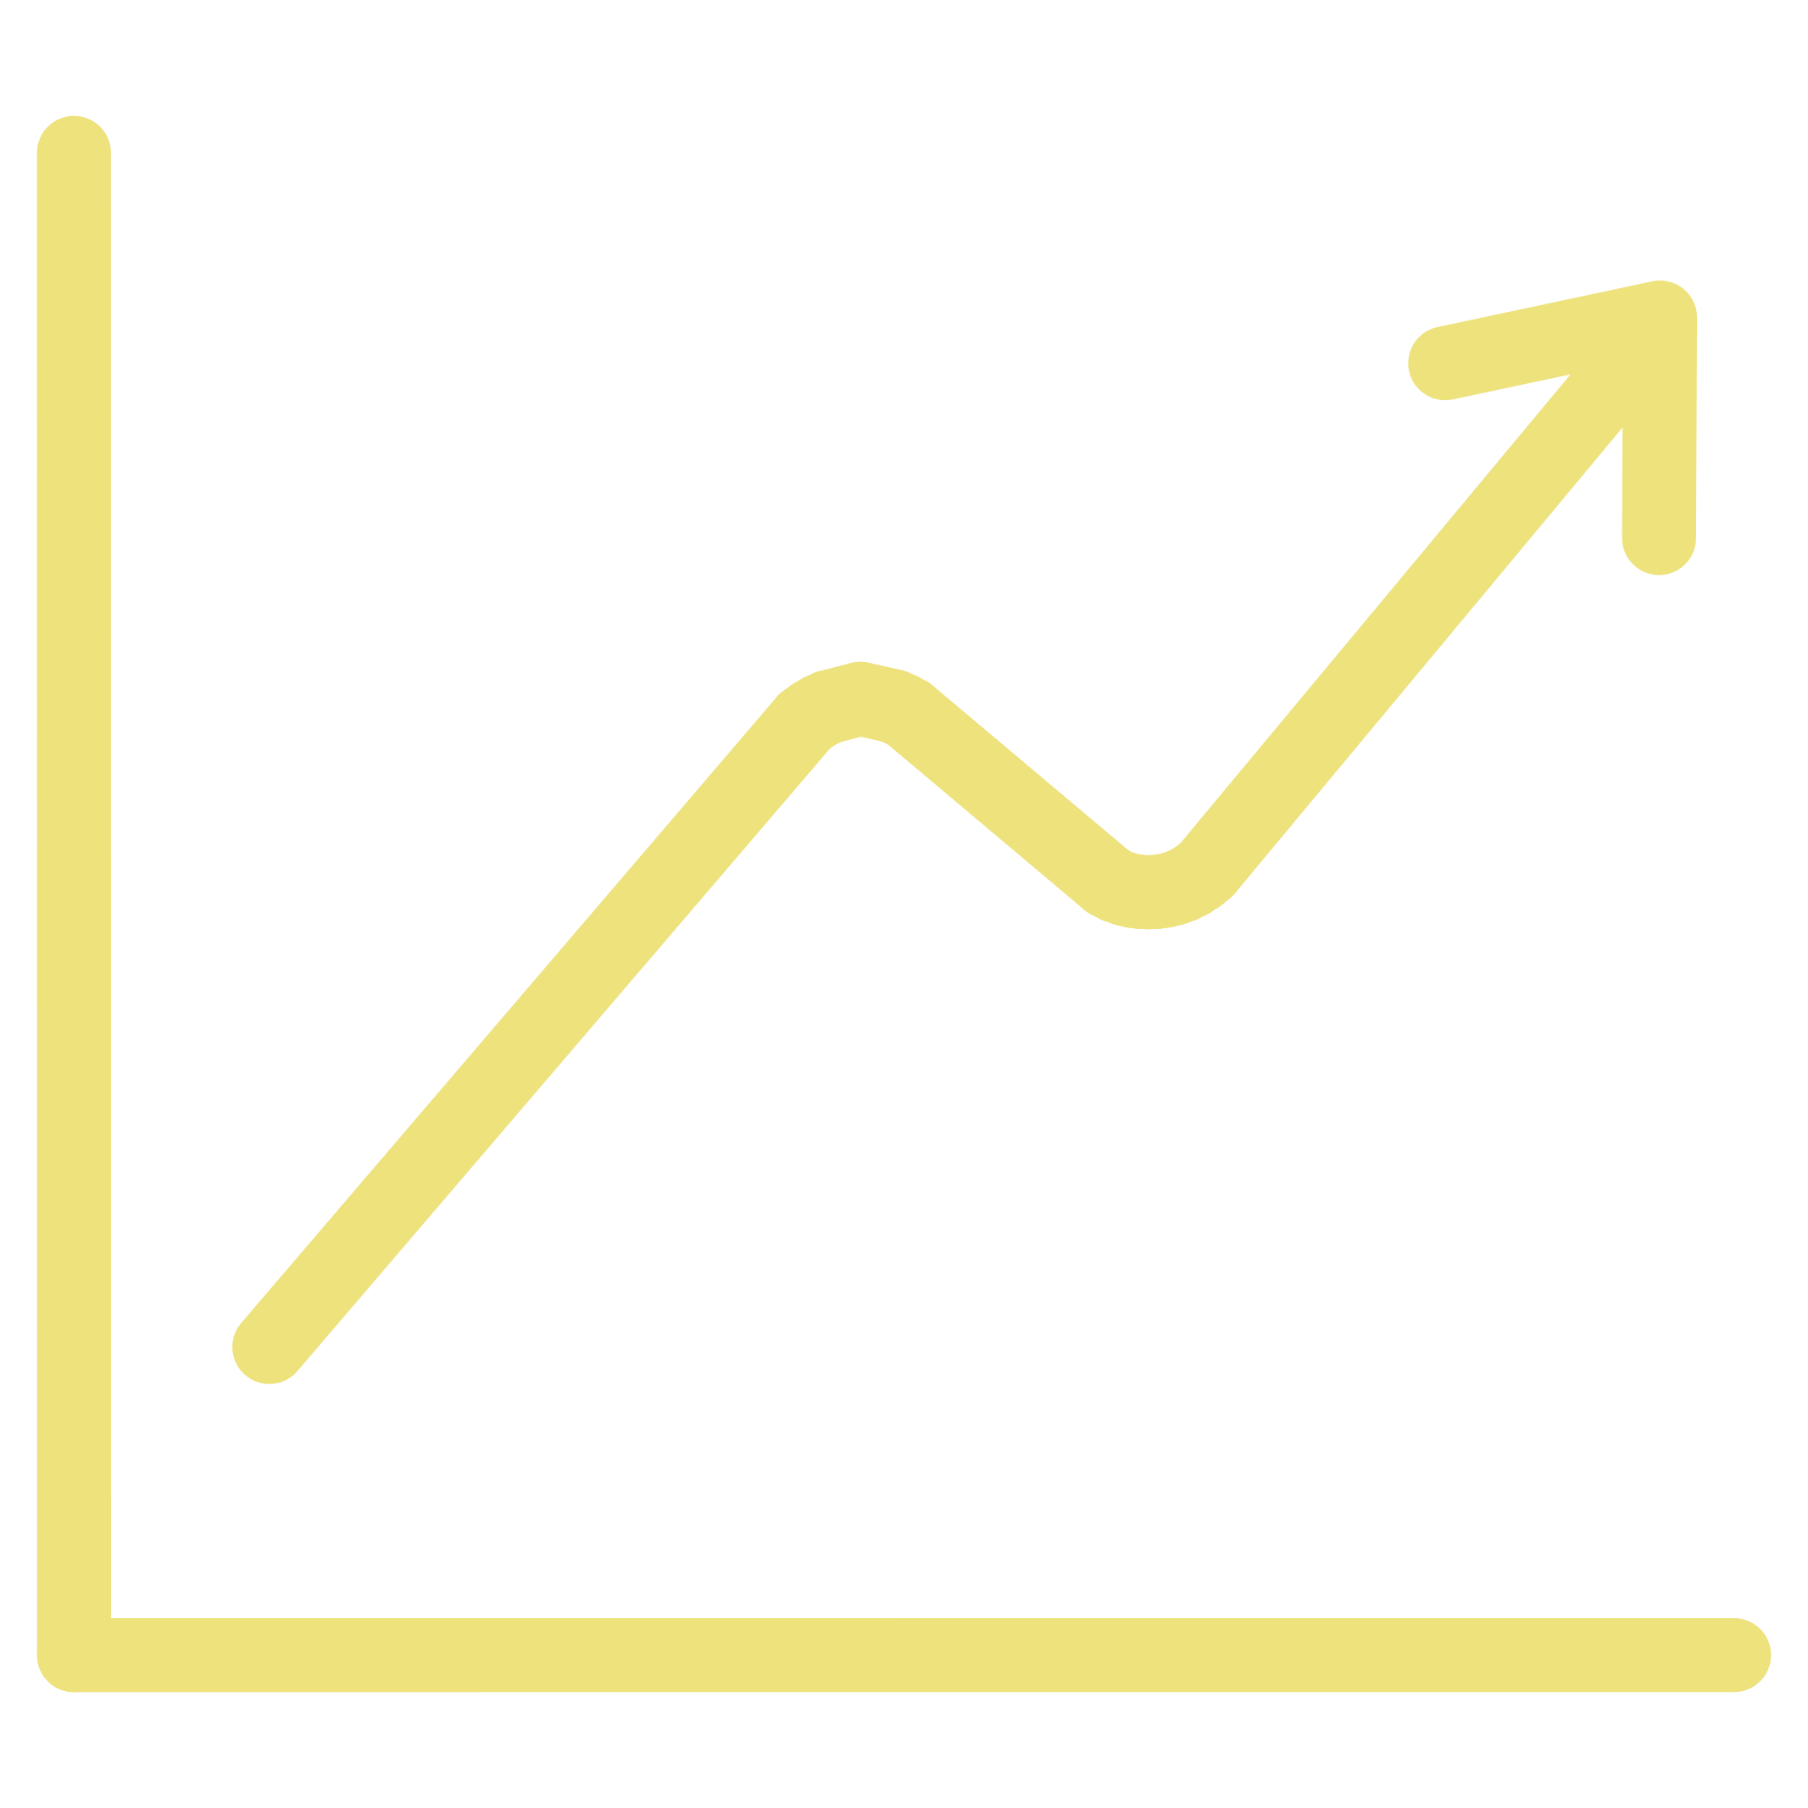


What an Advanced Website Actually Does
A high-performing website doesn't just look professional — it works for you around the clock.
Captures Leads
Tracks Behavior
Smart forms and offers that convert visitors before they bounce
Know exactly what visitors do and where they drop off
Books Appointments
Answers Instantly
Automated scheduling that fills your calendar without lifting a finger
Live chat and automation that respond to questions at any hour

Slide 4
The Businesses Winning Today Convert More
They're not always spending more on marketing. They're converting more of the traffic they already have.
Double Your Leads
Know Your Sources
Work While You Sleep
Without doubling your ad budget — just by converting more of the visitors already arriving
See exactly where every customer came from, so you can invest smarter
A website that captures opportunities 24/7 — even when you're off the clock

Slide 5


THE SHIFT
From Website to Revenue-Generating System
There's a fundamental difference between a website that exists and a system that performs.
Builds Trust
Captures Opportunity
Grows 24/7
Credibility that turns first-time visitors into confident buyers
No lead left behind — every visitor gets a path to conversion
Your business develops revenue while you focus on delivery

Slide 6



Is Your Website Making You Money — or Costing You?
Every day without a converting website is another day of traffic, ad spend, and opportunity walking out the door.
If you're ready for a website built to generate results — not just look good — let's talk. The businesses growing fastest aren't the ones spending the most. They're the ones converting the best.

